Slide 1

IBM ZD&T Architecture

Slide 2


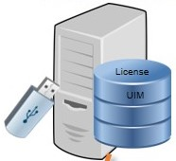
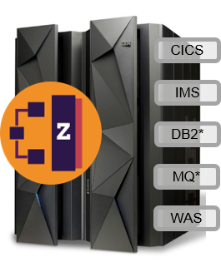



IBM ZDT Architecture
ZD&T Enterprise Edition Web Server
ZD&T Software
+ Based Licensed Server
Source Z or ZD&T or ADCD
SSL
SSH Connection
Commands via FTP/SFTP
SSH Connection
License Validation
Data Transfer via FTP/SFTP
Data Transfer via FTP/SFTP
Target Machine (zD&T image)
Image Server

Slide 3
Web Portal Features

Slide 4
Web Portal Features
Component
Image
1
IBM Z Mainframe Datasets
1
ZD&T Components
2
IBM Z Mainframe Volumes
2
ADCD – Application Developers Controlled Distributions
3
IBM Z Mainframe CICS
3
ZD&T image checkpoint content
4
IBM Z Mainframe DB2
5
IBM Application Discovery Projects

